Slide 1
DATA WAREHOUSING IN IOT ANALYTICS
Soumyadeep Basu
2017B5A31056H
A PS 2 project at Samsung Research Institute, Bangalore.

Slide 2
RECAP
We went through the concepts of SQL, Amazon Web Services (AWS) and Amazon Redshift.
We demonstrated few codes of SQL which will be of importance in the project.
We discussed the concepts of Data warehousing.
With these concepts, we go ahead with the project.

Slide 3
INTRODUCTION
We take further steps to lay the base of the applications which we would require for this project before we discuss the entire execution.
The motive is to analyse a dataset and draw conclusions from it.
The dataset will contain series of values conformed over time and recorded historically.
We would setup the entire project using AWS platform.

Slide 4
DATA PIPELINE
It is a series of tools and actions for organizing and transferring the data to different storage and analysis systems.
It automates the ETL process, extraction, transformation, load.
Data pipeline is going to be one of the most important part of the project.
We need to discuss how a data pipeline works.

Slide 5
How does a data pipeline work?
The raw unstructured data is located at the beginning of the pipeline, then it passes a series of steps and each of them transforms the data.
Step one is collecting the data. At this stage the system gathers the data from thousands of sources such as databases, APIs, cloud sources and social media.
Step two is extraction. After the raw data is collected, the system starts reading each piece of data using the data sources’ API and after the data is extracted it goes through processing. If the sets of records are extracted and counted as one group, batch processing is applied. Real-time processing passes individual records as soon as they are created or recognized. By default, the companies use batch processing since it is easier and cheaper.

Slide 6
How does a data pipeline work?
Step 3 is transformation and standardization. Now we need to adjust the structure or format of the data. Among the most common types of transformation are basic transformations in which only the appearance and format of the data is affected without severe content changes, and advanced transformations in which the content and the relationship between data sets are changed.
Step 4 is destination and this is the final point where the clean data is transferred further they can go to data warehouses while less structured data is stored in data lakes.
Step five is monitoring to ensure that the data is accurate. Engineers continuously check the pipeline data by monitoring, logging and alerting the code.

Slide 7
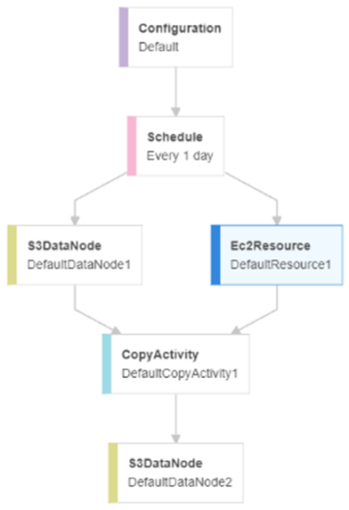
AWS DATA PIPELINE
AWS data pipeline is a web service allowing data processing and moving it between different computing services AWS storage and local data sources.
It helps to easily create complex data processing, pipeline operations and guarantee their fault tolerance and high availability.
For our project we have created a data pipeline which is going to copy data from an S3 bucket to another S3 bucket. The data pipeline is scheduled to run once everyday and copy the data from a source bucket to a destination bucket.

Slide 8
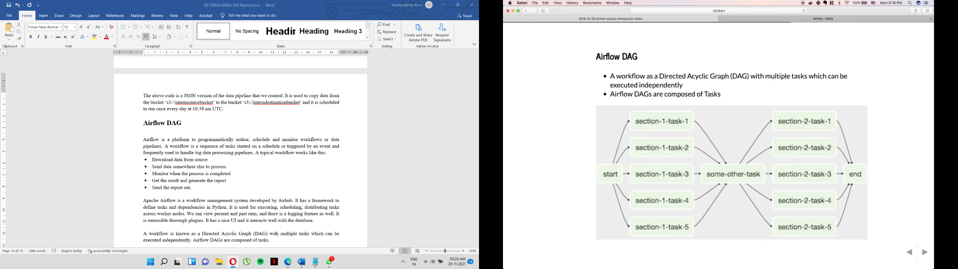
Airflow DAG
Apache Airflow is a workflow management system developed by Airbnb. It has a framework to define tasks and dependencies in Python.
It is used for executing, scheduling, distributing tasks across worker nodes.
We can view present and past runs, and there is a logging feature as well.
It is extensible thorough plugins. It has a nice UI and it interacts well with the database.
A workflow is known as a Directed Acyclic Graph (DAG) with multiple tasks which can be executed independently. Airflow DAGs are composed of tasks.

Slide 9
Airflow DAG
Airflow has a great application in Data warehousing. It cleanses, organizes, does data quality checks, and publish/stream data into our growing warehouse. It is widely used in the study of analytics.
Apache Airflow can be implemented in AWS using Amazon Managed Workflows for Apache Airflow (MWAA).
MWAA deploys Apache Airflow rapidly with the same open-source Airflow and the same Airflow UI. It implements the AWS Management console, AWS CLI, API, or AWS CloudFormation with Airflow.
We can create an MWAA environment, copy our DAGs and plugins to Amazon S3 and access the Airflow. The MWAA environment is created under the appropriate IAM roles, VPC subnets and the S3 buckets for the DAG are to be allotted.

Slide 10
WORKING WITH THE DATASET
The dataset is a set of values conformed over time and stores data in a historical manner with the timestamps.
The dataset we used contains sensor data that was collected in the home of a volunteer adult couple. The residents in the home were a man, a woman, and a dog. The couple's children also visited the home on at least one occasion.
The following activities are annotated within the dataset:
• Bed to toilet
• Breakfast
• R1 sleep
• R1 wake
• R1 work in office
• Dinner
• Laundry
• Leave home
• Lunch
• Night wandering
• R2 sleep
• R2 take medicine
• R2 wake

Slide 11
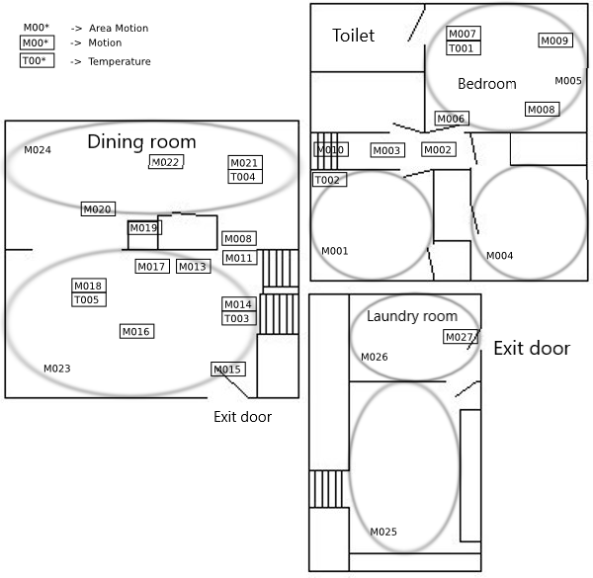
WORKING WITH THE DATASET
The sensor events are generated from motion sensors (these sensor IDs begin with "M") and temperature sensors (these sensor IDs begin with "T"). The layout of the sensor is as follows:

Slide 12
WORKING WITH THE DATASET
The certain section of the dataset is shown below to show how the data is recorded:
The date and timestamp are show along with the sensor name and its status. We need to program certain codes to detect the activities from the sensor data.
2009-06-10 06:14:59.029206 M005 ON
2009-06-10 06:14:59.087507 M007 ON
2009-06-10 06:15:06.053773 M007 OFF
2009-06-10 06:15:11.004895 M007 ON
2009-06-10 06:15:15.082658 M007 OFF
2009-06-10 06:15:16.019862 M005 OFF
2009-06-10 06:15:37.008132 T004 16
2009-06-10 06:15:37.035657 T003 16.5
2009-06-10 06:15:53.049202 T003 17
2009-06-10 06:16:08.030746 T003 16.5
2009-06-10 06:16:24.030179 T004 16.5
2009-06-10 06:16:24.005713 T003 17
2009-06-10 06:16:28.097232 M005 ON

Slide 13
KPI
A Key Performance Indicator is a measurable value that demonstrates how effectively a company is achieving key business objectives.
Organizations use KPIs at multiple levels to evaluate their success at reaching targets.
KPIs allow users, managers and companies to measure and manage targets and goals.
We can use simple KPIs to track project performance and report to the project shareholders.

Slide 14
KPI
The KPIs for our dataset are:
Bed to toilet
Breakfast
R1 sleep
R1 wake
R1 work in office
Dinner
Laundry
Leave home
Lunch
Night wandering
R2 sleep
R2 take medicine
R2 wake

Slide 15
KPI
We can use this KPIs to track and analyse the user’s daily routine and schedule and can draw certain conclusions. Before we analyse the data, we need to set up a platform to carry out our analysis.
We need to run SQL queries on the dataset to determine the results.
To run SQL queries in AWS, we need to use AWS Athena/Spectrum as a platform.
AWS Athena can be set up with the proper IAM roles, subnets and S3 locations.

Slide 16
ANALYSIS
To analyse the dataset, we need to select one KPI from the dataset.
Let’s take “Lunch” KPI as an example.
With proper observation, we realise that there is movement in the dining room between 12pm to 1pm. The sensors M021, M024, M022 are in ON status during that time, this indicates that lunch is happening.
So, our necessary requirements to detect the beginning of lunch are:
Time should be between 12:00 and 13:00.
M021, M024, M022 needs to be active and in ‘ON’ status.

Slide 17
ANALYSIS
The SQL code for beginning of lunch is:
with cte as
(select cast(Time as date)[Date], *, ROW_NUMBER() OVER (PARTITION BY cast(Time as date) ORDER BY Time ASC) AS rn
from [cairo].[dbo].[data - Copy]
where cast(Time as time) between '12:00:00.000' and '13:00:00.000'
and (sensor ='M021' or sensor = 'M024') and status = 'ON'
)
select Date,cast(Time as time)[Time], 'Lunch begins expected' as KPI_expected
from cte
where rn=1

Slide 18
ANALYSIS
Output:
2009-06-10 12:23:01.0000000 Lunch begins expected
2009-06-11 12:06:16.0000000 Lunch begins expected
2009-06-13 12:14:11.0000000 Lunch begins expected
2009-06-14 12:00:56.0000000 Lunch begins expected
2009-06-15 12:00:04.0000000 Lunch begins expected
2009-06-18 12:00:29.0000000 Lunch begins expected
2009-06-19 12:00:11.0000000 Lunch begins expected
2009-06-20 12:00:04.0000000 Lunch begins expected
2009-06-21 12:00:01.0000000 Lunch begins expected
2009-06-22 12:00:02.0000000 Lunch begins expected
2009-06-23 12:01:43.0000000 Lunch begins expected
2009-06-24 12:00:06.0000000 Lunch begins expected
2009-06-25 12:12:13.0000000 Lunch begins expected
2009-06-26 12:01:42.0000000 Lunch begins expected
2009-06-28 12:12:58.0000000 Lunch begins expected
2009-06-29 12:00:20.0000000 Lunch begins expected
2009-06-30 12:05:04.0000000 Lunch begins expected
2009-07-01 12:00:11.0000000 Lunch begins expected
2009-07-03 12:20:20.0000000 Lunch begins expected
2009-07-04 12:00:17.0000000 Lunch begins expected
2009-07-05 12:01:10.0000000 Lunch begins expected
2009-07-08 12:00:58.0000000 Lunch begins expected

Slide 19
ANALYSIS
Similarly, we could show the output of “Lunch ends”. The criteria then become different.
We observe that between 1pm and 1:30pm, the sensors in the dining room turn off. Hence, lunch ends at this time interval.
The conditions are:
Time should be between 13:00 and 13:30.
M021, M024, M022 needs to be active and in ‘OFF’ status.

Slide 20
ANALYSIS
The SQL code for end of lunch is:
with cte as
(select cast(Time as date)[Date], *, ROW_NUMBER() OVER (PARTITION BY cast(Time as date) ORDER BY Time ASC) AS rn
from [cairo].[dbo].[data - Copy]
where cast(Time as time) between '13:00:00.000' and '13:30:00.000'
and (sensor ='M021' or sensor = 'M024' or sensor = 'M022') and status = 'OFF'
)
select Date,cast(Time as time)[Time], 'Lunch ends expected' as KPI_expected
from cte
where rn=1

Slide 21
ANALYSIS
Output:
2009-06-10 13:00:21.0000000 Lunch ends expected
2009-06-11 13:03:51.0000000 Lunch ends expected
2009-06-13 13:11:23.0000000 Lunch ends expected
2009-06-14 13:19:07.0000000 Lunch ends expected
2009-06-15 13:04:32.0000000 Lunch ends expected
2009-06-18 13:18:56.0000000 Lunch ends expected
2009-06-19 13:10:59.0000000 Lunch ends expected
2009-06-22 13:00:02.0000000 Lunch ends expected
2009-06-24 13:00:00.0000000 Lunch ends expected
2009-06-25 13:00:19.0000000 Lunch ends expected
2009-06-26 13:04:22.0000000 Lunch ends expected
2009-06-27 13:02:58.0000000 Lunch ends expected
2009-06-30 13:02:40.0000000 Lunch ends expected
2009-07-03 13:03:23.0000000 Lunch ends expected
2009-07-05 13:13:09.0000000 Lunch ends expected
2009-07-08 13:20:01.0000000 Lunch ends expected
2009-07-09 13:06:39.0000000 Lunch ends expected
2009-07-11 13:00:09.0000000 Lunch ends expected
2009-07-12 13:00:29.0000000 Lunch ends expected
2009-07-13 13:01:55.0000000 Lunch ends expected
2009-07-14 13:00:01.0000000 Lunch ends expected
2009-07-17 13:00:51.0000000 Lunch ends expected
2009-07-18 13:00:05.0000000 Lunch ends expected
2009-07-20 13:00:34.0000000 Lunch ends expected
2009-07-22 13:00:41.0000000 Lunch ends expected

Slide 22
ANALYSIS
Similarly, we can detect the other KPIs using the various conditions that we observe.
In case of breakfast, we can apply the same conditions of lunch, only the time criteria need to be changed to early morning timings.
Similarly for dinner, we need to change the time criteria to night timings.
For ‘Bed to Toilet’ movements, we need to check the sequential activity of the sensors around that area.
For night wandering we need to check for the motion sensors throughout the house at late night timings (post dinner, so that it doesn’t overlap).
For sleep, we check if the bedroom sensors at night are in ‘OFF’ state.
For wake, we check if the bedroom sensors at early morning are in ‘ON’ state.
For exit, we check if the sensors near the exit are in ‘ON’ or not.
We can check the motions of R1 and R2 using the reading of temperature sensors.

Slide 23
PRACTICAL APPLICATION
What is the real-life motive of this project?
We imagine a house with various rooms, with a simple system of two types of sensors, that is motion and temperature sensors, located at various corners of each room.
The dataset that we observe in the project is a combination of data recorded over a span of 3 months. In real life scenario, the data would be recorded everyday by these sensors and stored in an S3 bucket. The movements of the individuals and their temperatures are stored on a daily basis.
Everyday new data is recorded and a new dataset is stored in the bucket. This forms a data lake.

Slide 24
PRACTICAL APPLICATION
The S3 bucket which acts as the data lake is connected to a destination S3 bucket through a data pipeline which is scheduled to run on a daily basis at a fixed point of time.
The data pipeline organises the raw data and stores it in a format which is ready for processing. The structured dataset is stored in the destination S3 bucket and is updated daily as the pipeline runs. The data is processed and is ready for testing.
The final dataset is analysed using various SQL codes and queries and the KPIs are detected. Based on the results, the observations and conclusions can be drawn.
This system demonstrated is a simple one which consists of two sensors and simple KPIs. Using the KPIs, we can derive further more KPIs and hence, a deeper analysis.

Slide 25
FUTURE IMPROVEMENTS
Future improvements involve using of more sensors, to fetch more data.
As the system grows complex, data will also be available in abundance and hence, more complex analysis can be done.

Slide 26
CONCLUSION
The different databases management software languages and softwares discussed in the project form the building blocks of our project.
IoT Analytics, as the name suggests, deals with the analysis of data obtained from interconnected IoT devices. The data obtained are stored in data warehouses in certain databases. Hence, the advanced concepts of DBMS come in handy when dealing with data analysis.
Furthermore, the data can be processed and analysed using AWS. The analysed data can give us information about the various conclusions drawn from the results of the dataset.
The model demonstrated is a minute version of home automation. Two simple sensors are used to record the movements and with that only, we are able to construct so many KPIs an derive so many results.

Slide 27
THANK YOU

